Slide 1
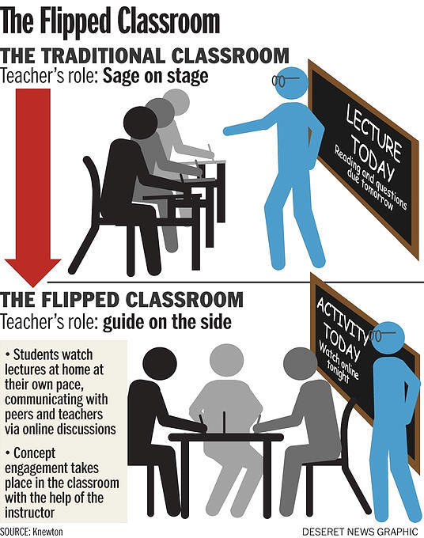
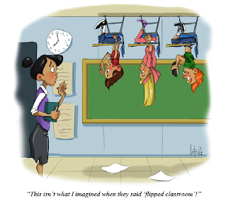
Conversation Class
Education
+ warm up
1. Do Schools kill creativity
2. Failure
Christopher bAUMAN

Slide 2
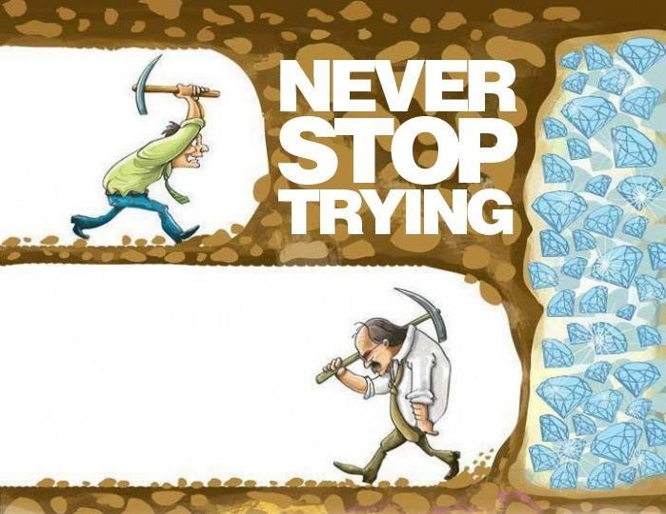
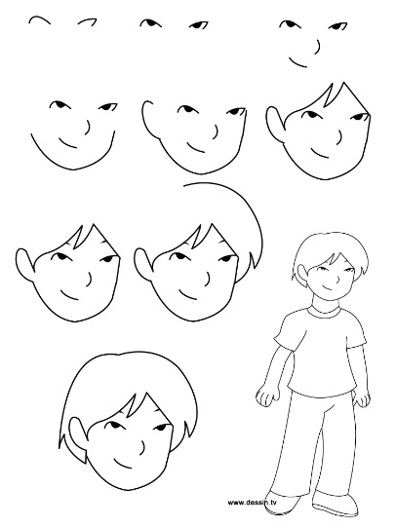
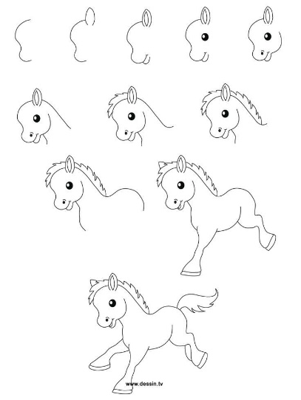
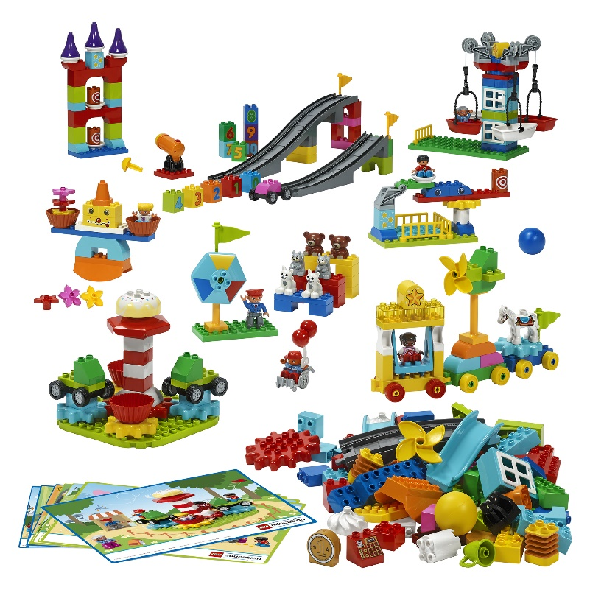
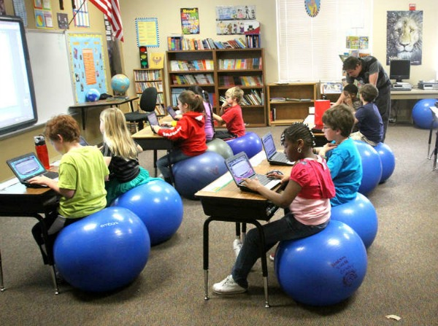
Education Infographic
1. Lessons from failure?
2. Gamification
3. Homeschooling
4. Difficult education?
5. Resilience
6. How have students changed
7. Peer learning
8. What are skills
9. How do you learn different skills
10 Short animation
Teachers
Education
Skills
Chris Bauman

